Slide 1
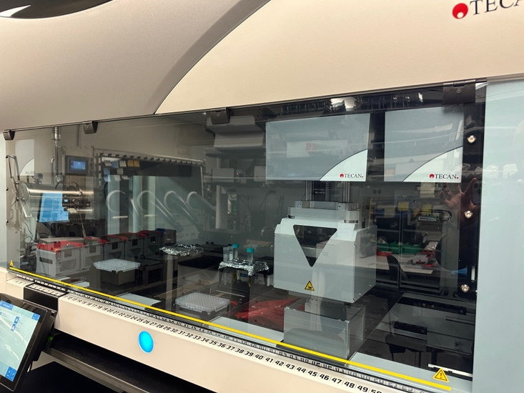
Automated liquid-handling platforms (pipetting robots)
these robots are precise—but not intelligent
If the layout inside the chamber changes—even slightly—or if equipment is placed in the way, the robot cannot react or plan around obstacles
Proposed RL environment
Current environment and actual movement
Pipetting head
Pipetting head
Inside chamber:
Clear path
Target 1
1
Pathway Obstacles
1
Target 1
2
2
Target 2
Target 2

Slide 2
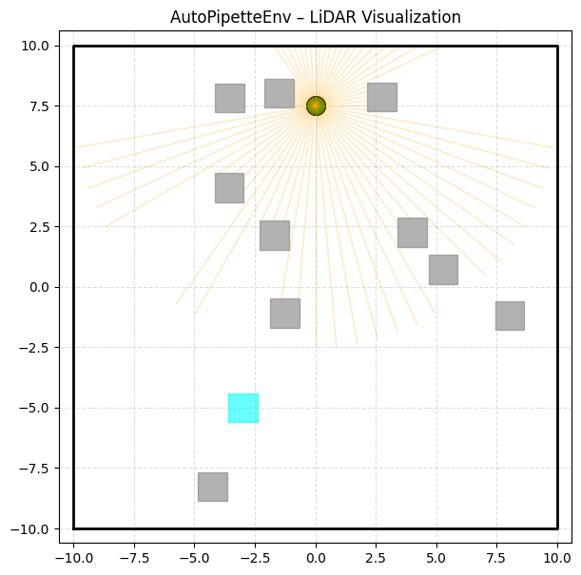
(pipetting robots)
navigation policy using the Soft Actor–Critic
Autopipette Env – LiDAR Visualization
Type | Name | Symbol | Value
Reward | Progress | 4.0 * (prev_dist - dist) | 4.0
Reward | Goal Attraction | 3.0 / (1 + dist) | 3.0
Reward | Free Space | 0.5 * free_space | 0.5
Reward | Final Approach | 5.0 * (goal_radius - dist) | 5.0
Reward | Success Bonus | +300 | 300
Penalty | Obstacle Proximity | -8 * (proximity_safe - min_lidar) | 8
Penalty | Collision | -80 | 80
Penalty | Slow Movement | -0.003 * (1 - v) | 0.005
Penalty | Step Cost | -0.001 | 0.001

Slide 3
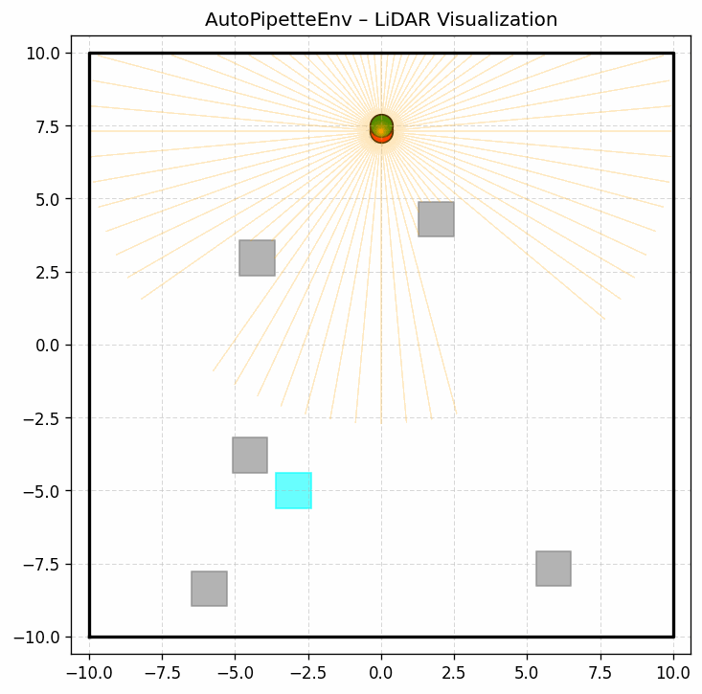
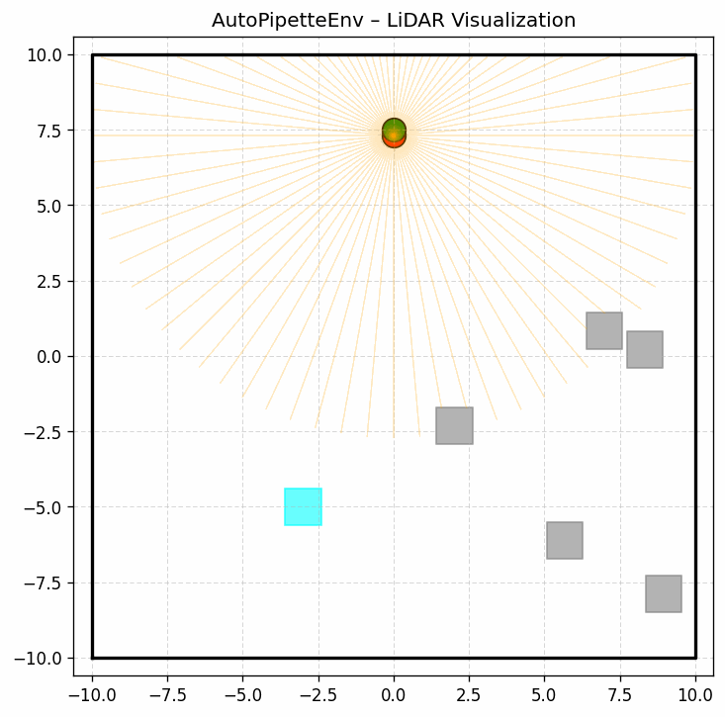
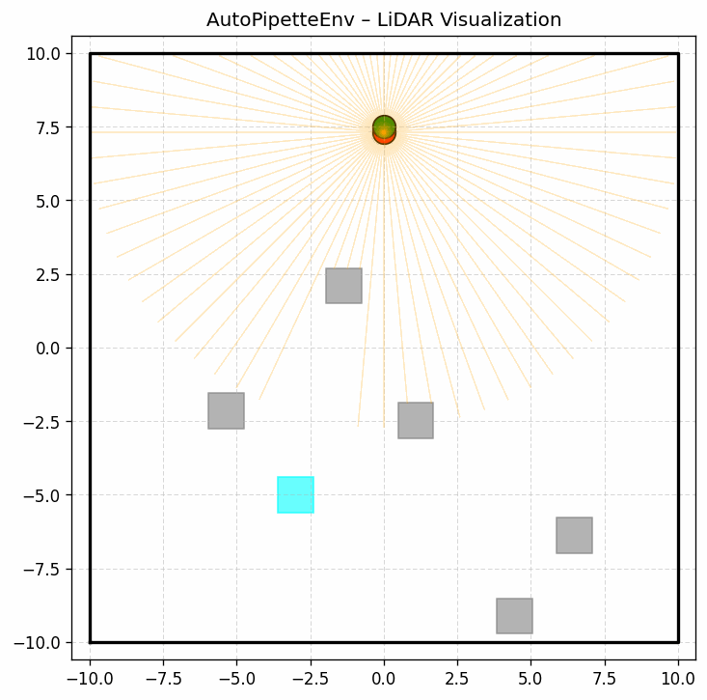
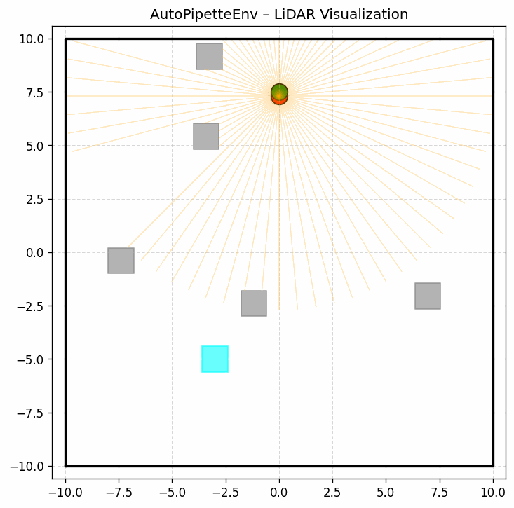
Soft Actor–Critic
Different arrangements
5 Obstacles
Simple

Slide 4
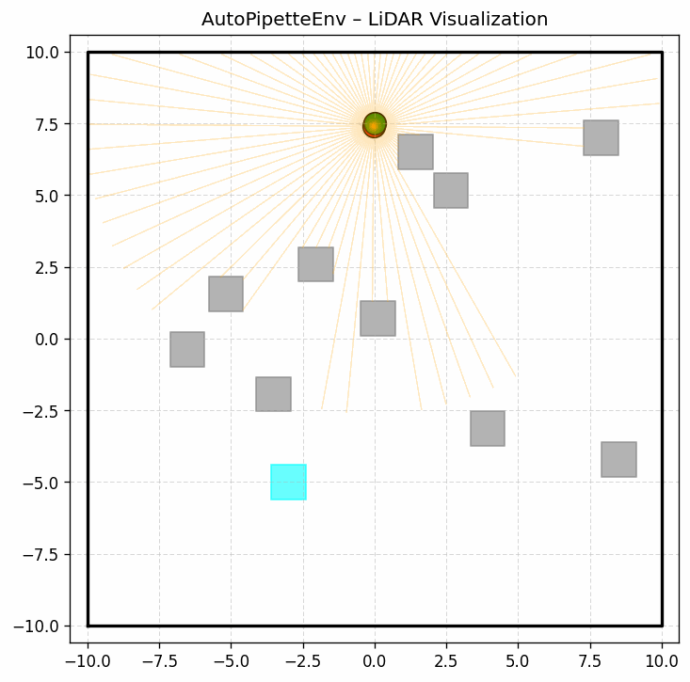
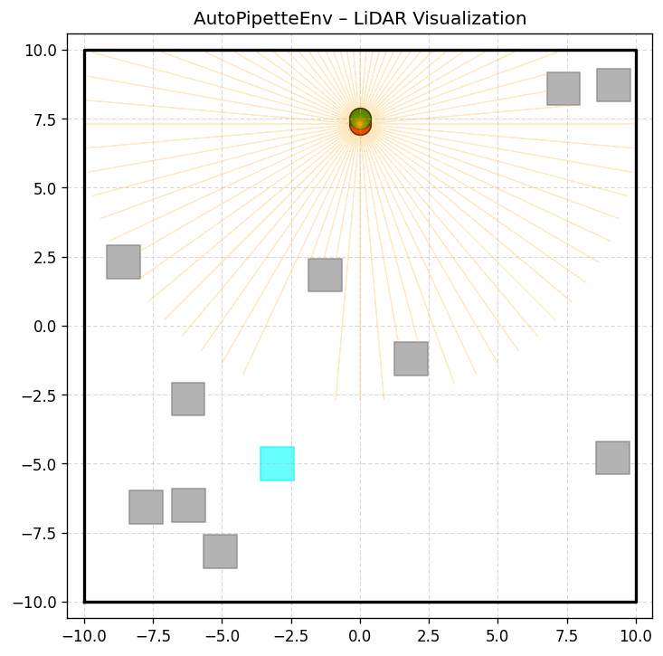
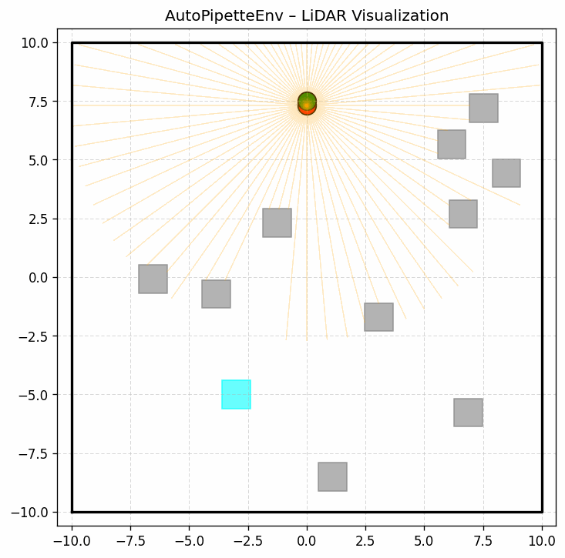
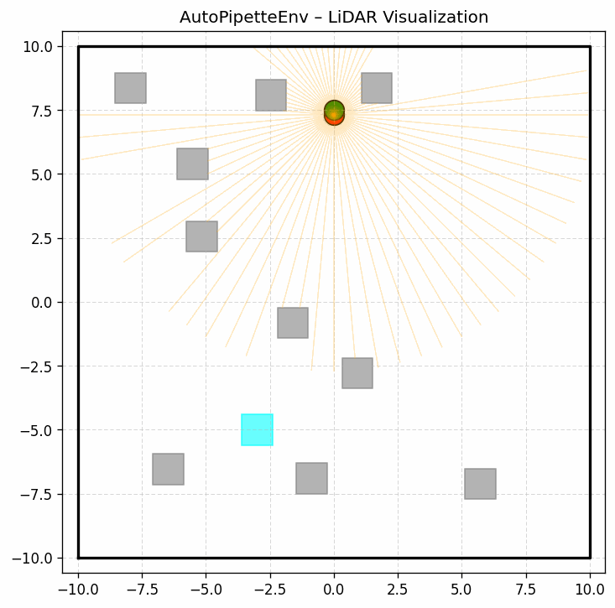
Soft Actor–Critic
Different arrangements
10 Obstacles
Moderate

Slide 5
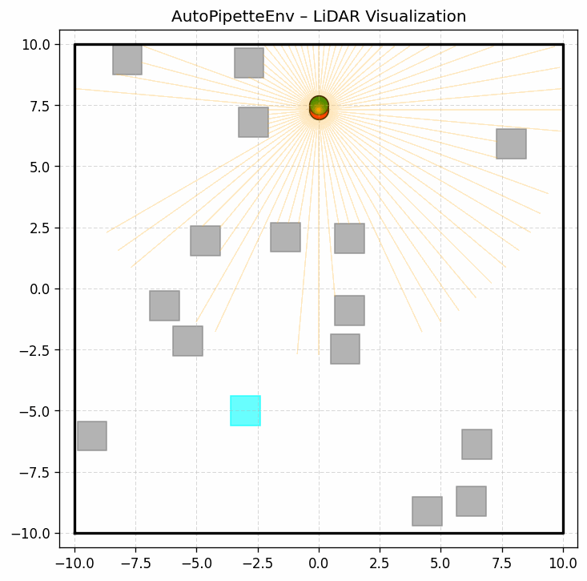
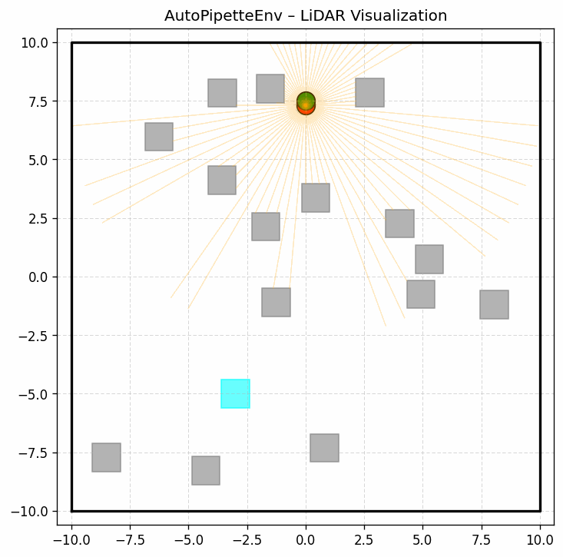
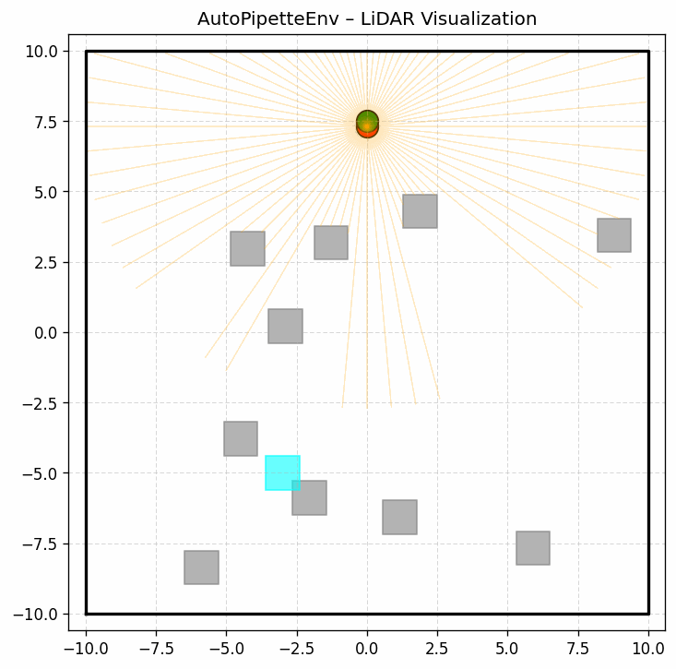
Soft Actor–Critic
Different arrangements
15 Obstacles
Complex
2. The obstacles and Goal are so close
1. There is no way to move forward but not panelized
Example of failure

